Slide 1
Instructions to test locally
There will be 2 folders GenuineSurveyJS and surveyjs-nodejs.
Surveyjs-nodejs folder is back end app which connects to postgresSq db
3.Install docker on your system
4. Run "docker run hello-world" to see if the docker installed correctly.
5.Now, follow along this in ./surveyjs-nodejs/docker/postgresql-db folder :
6.Build postgresql-db docker container via `docker build -t postgresql-db .` command in the `docker/postgresql-db` folder
7.Start docker container via the `docker run --name dbsrv -p 5432:5432 -d postgresql-db` command
8.To list all the containers use "docker ps -a" . This will list all the containers with their IDs and status.
9. To start a specific container use "docker start <container name>"
And after these initial steps you can use this commands to activate the postgresDB in terminal you can use these commands :
a. docker exec dbsrv bash (Enable dbsrv to open in bash terminal )
b. docker exec -tiu postgres dbsrv psql (Actual command to start the postgresDB in terminal)
Postgres commands:
\l : list the DBs....
\c DB Name : Use DB comd
\d : List tables
select query and others work fine...
Above instructions + how to run app is in below github repo .
https://github.com/surveyjs/surveyjs-nodejs
Do not clone above repo. I already cloned. You just need to run npm i , npm start

Slide 2
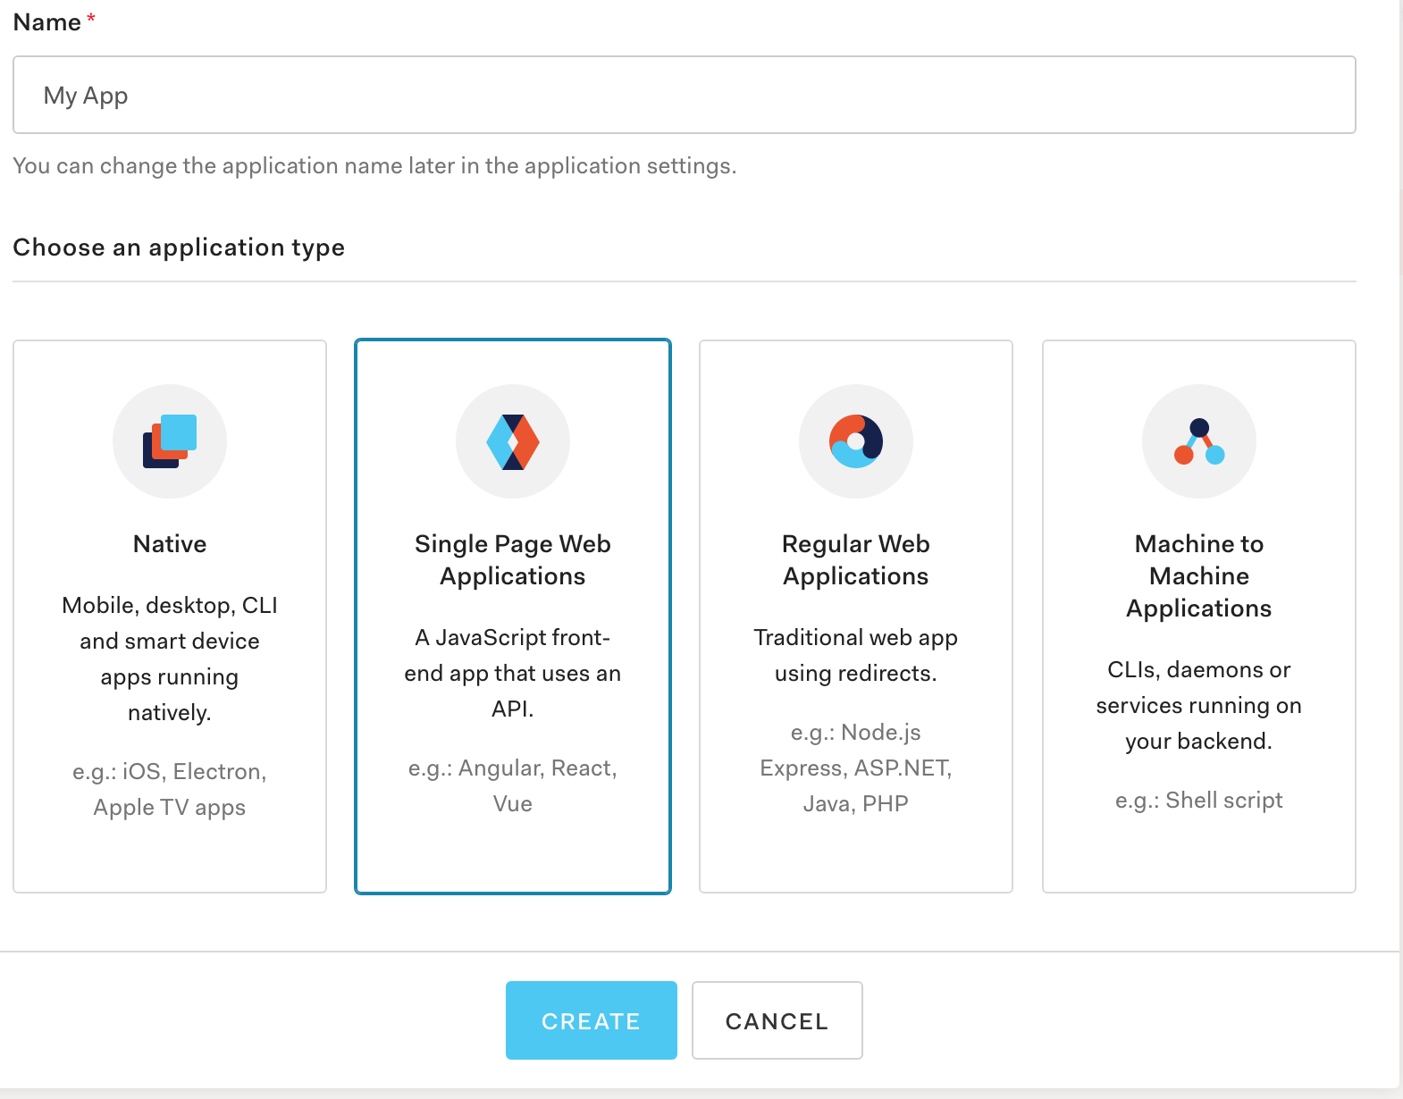
Instructions to test locally
Now GenuineSurveyJS is front end react app
I am using http://www.auth0.com/ for authentication.
Login to above web site , sign up , create new application. Select Single Page Web Application then create

Slide 3
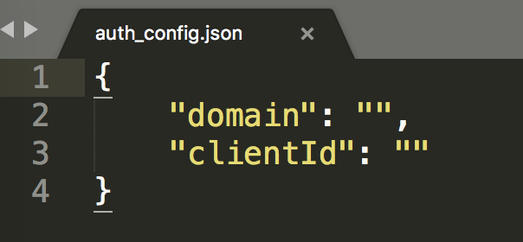
Instructions to test locally
Now GenuineSurveyJS is front end react app
Then click app link, go to settings, note Domain and Client Id values. You need to enter these values in the next step
Open auth_config.json file under src folder of GenuineSurveyJS folder , and replace the Domain and Client ID from step above.

Slide 4
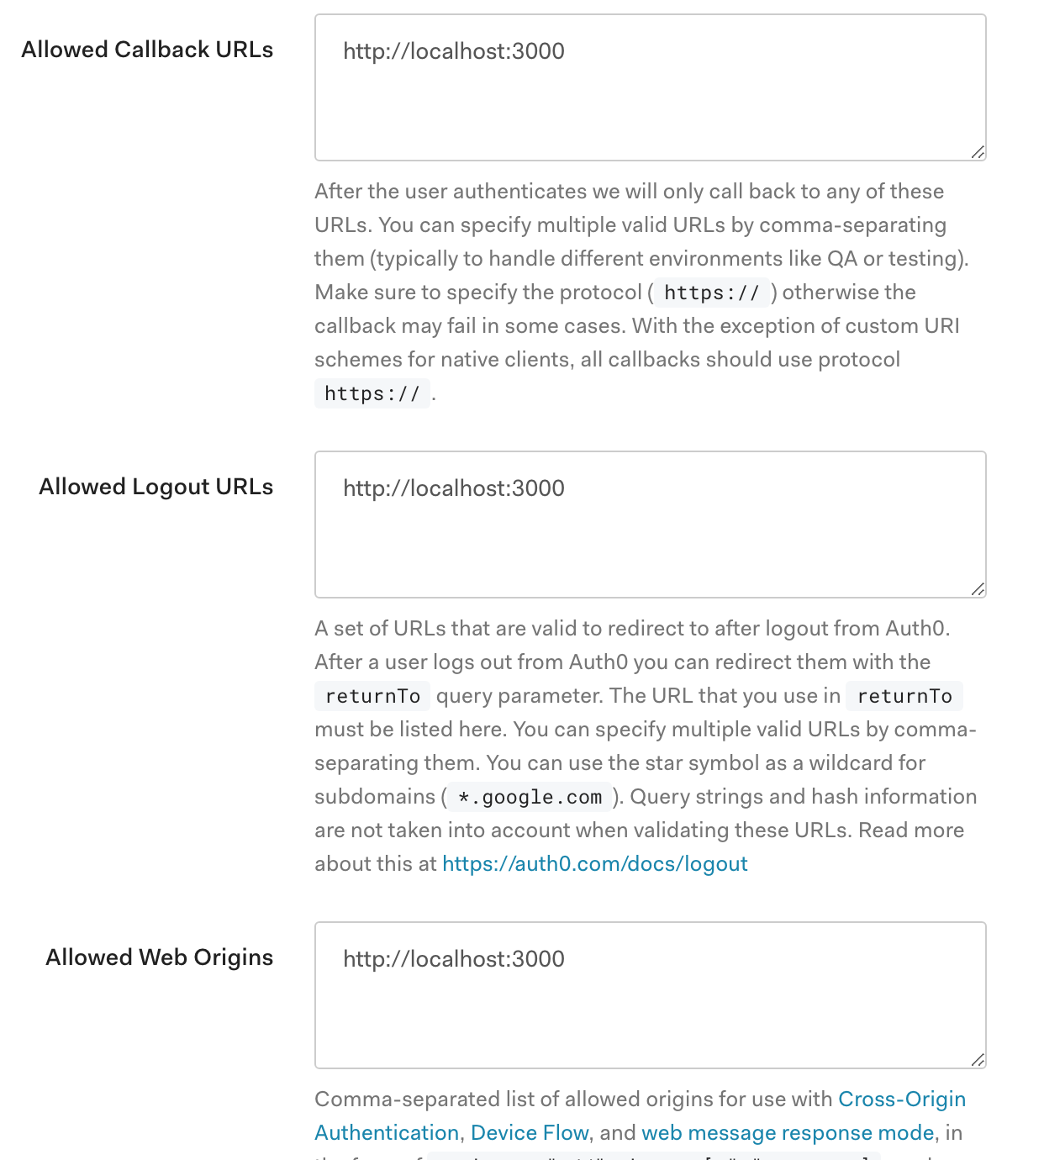
Instructions to test locally
Now GenuineSurveyJS is front end react app
Go to www.auth0.com , and in settings put http://localhost:3000, in following three options:

Slide 5
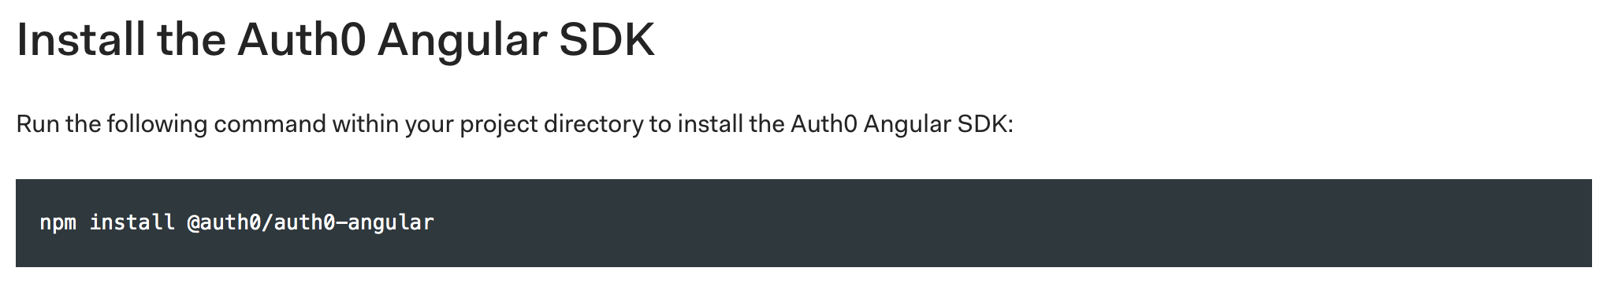
Instructions to test locally
Now GenuineSurveyJS is front end react app
Then you can run npm i, then npm start in terminal to start this app. In port 3000
Go to http://localhost:3000/profile , you will be asked to login with credential from auth0
Open another terminal, go to \src\server folder , then type node server.js, it will run on 5000,
This connects to postgres db you set up in docker in back end app.
After everything goes well, you will see logout, surveyex, surveydone button link on right corner.
Ping me if any issue. Then I tell you how to test both the app. Then you can deploy to Heroku.

